Slide 1
Integrating organisational thinking, strategy and reporting
Cbus case study
ACCA & <IR> Business Network webinar
23 June 2021
Robbie Campo, Group Executive – Brand Engagement Advocacy & Product

Slide 2
Disclaimer
Cbus' Trustee is United Super Pty Ltd ABN 46 006 261 623, AFSL 233792 Cbus ABN 75 493 363 262. This information is about Cbus It does not take your specific needs or circumstances into consideration, so you should look at your own financial position, objectives and requirements and seek financial advice before making any financial decisions. For more information visit www.cbussuper.com.au.

Slide 3
<Integrated Reporting> a natural fit for Cbus
Australian Pension Fund
Established in 1984 for/by Building and Construction workers – now public offer
$64b AUD
765,000
All-profits-to members
Total funds under management
Number of members
Notes:
Thanks and acknowledgement
Welcome the ACCA report and continued guidance and encouragement for <IR>.
Cbus overview including heritage and why that’s important in the context of this discussion from the perspective of:
Holding and directing members capital in trust and in their long-term holistic interest
The close and enduring relationship of stakeholders with their Fund – including the equal representation governance model
Our <IR> journey initiated by our desire to role model the type of reporting we wanted to see from the companies we invest in… so our <IR> journey has been as both an adopter and as a consumer of <IRs>
The ACCA report and in particular the top ten tips reflect many of our own lessons
Will seek to enlarge on these points as we step through the presentation.

Slide 4
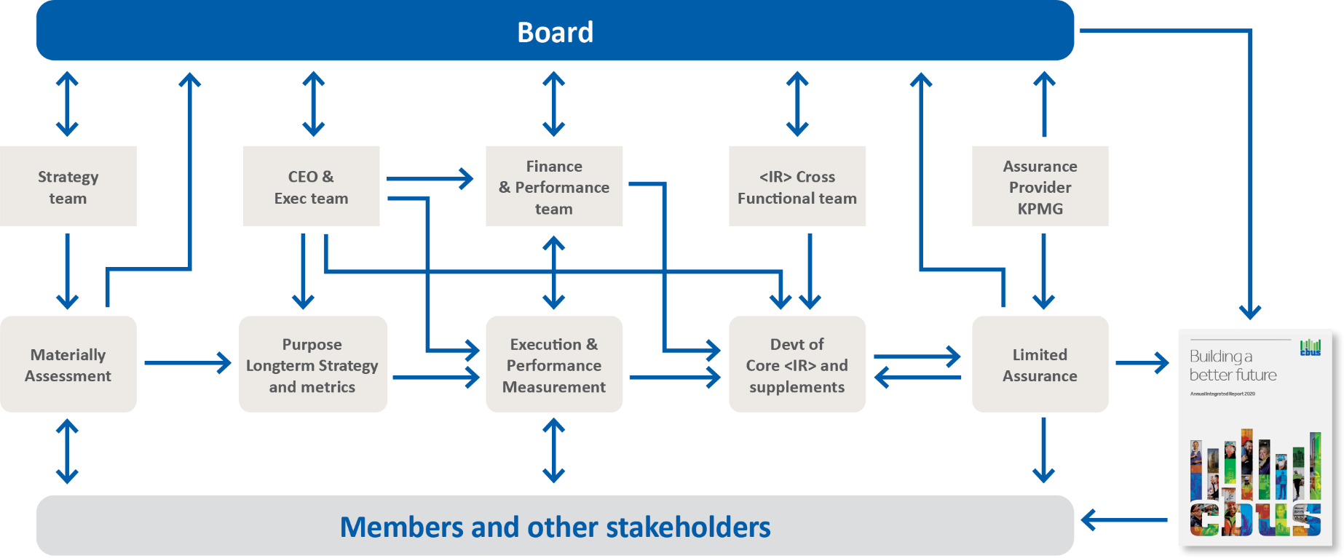
Integration takes collaboration
Annual process of Integrated Thinking & Reporting <IR>
Notes:
Our <IR> journey is an exemplar of the value derived from cross functional collaboration. So this graphic might look like a bowl of spaghetti but this only captures the level of ongoing collaboration at the highest level!
Responsibility for our report is an all of enterprise undertaking – increasingly integrated into organisational strategy.
We establish a cross functional steering committee each year to guide and assist with the development of the report – senior leaders from each functional area to guide narrative, themes and content.
Responsibility for stakeholder materiality now rests with our corporate strategy team, as an input to strategy.
Our external environment scans, stakeholder engagement and material issues, strategy and strategy scorecard are mirrored in our business plan and <IR>.
Strong buy-in to our <IR> from our Board – who want to see transparent reporting of their strategy and how we create value for the members whose interests they represent. As you can see the board is involved throughout the strategy and reporting processes.
Strong buy-in from CEO – both past and present – ensuring <IR> is embedded in the organisation. Anecdote re Justin – his intro to Cbus was via our annual report – he was an immediate convert!
Strong support from our Exec.
ACCA tip: collaborate, from the start and Tone from the Top

Slide 5
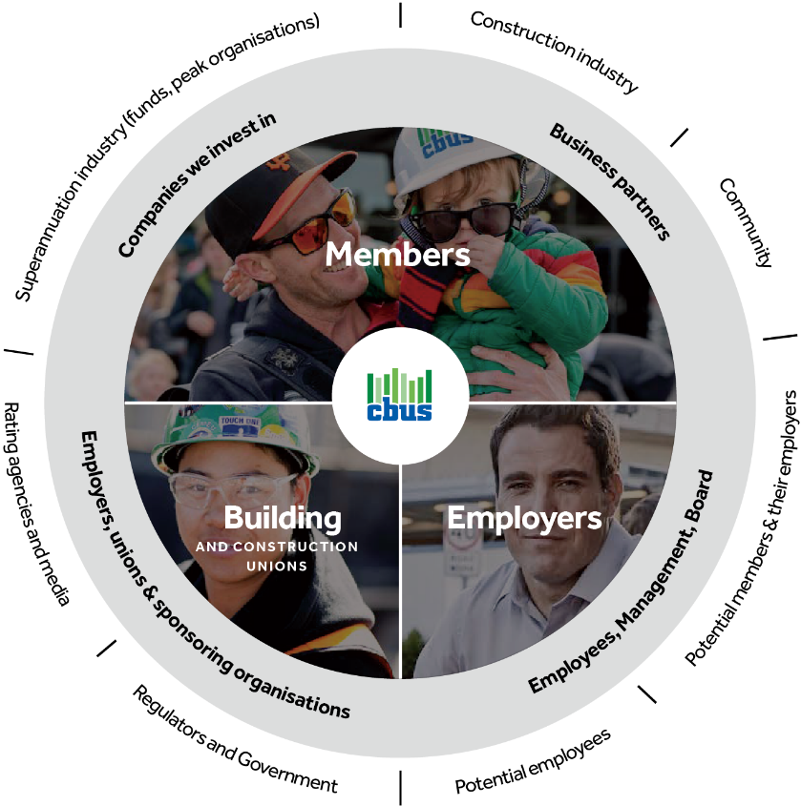
Material matters matter – stakeholders and purpose
Strategy and <Integrated Thinking> founded on Stakeholders' material issues
Heritage and governance structure embeds Cbus' connectedness with stakeholders but strengthened further by <IR>
Continuous stakeholder materiality loop
Notes:
Organisationally, we have always been attuned to our stakeholder’s material issues – Board – Management – team.
This stems from our heritage and our governance model as mentioned.
Materiality remains a key input into strategy development but we build in a continuous loop of engagement throughout execution.
Adoption of <IR> has allowed us to deepen engagement and further embed strategic agility to respond.
2 way stakeholder flows have proven invaluable to our business decisions – eg. - Points of difference in maintaining and expanding face-to-face services; responding to changing stakeholder needs during COVID; investing in our members’ industry and creating jobs. Member meetings at conclusion of reporting process.
ACCA tip: materiality as a management tool

Slide 6
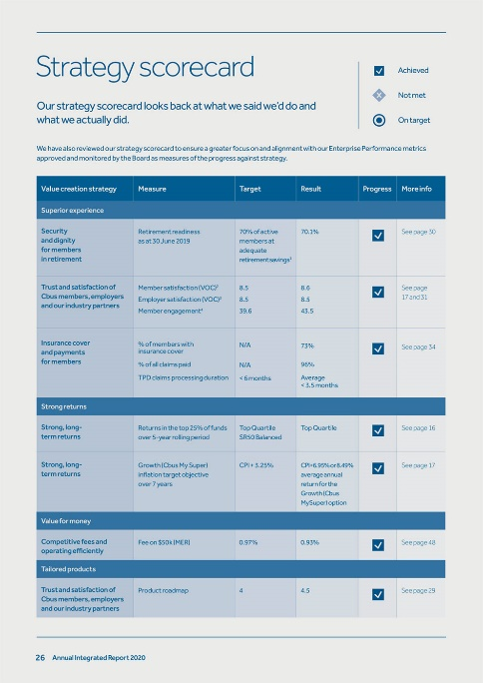
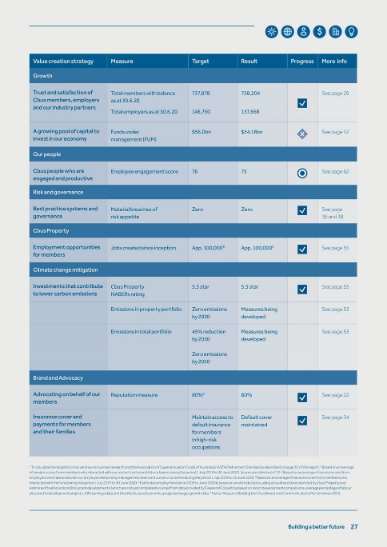
Strategic goals and connectedness
Rolling yearly measures
Medium and longer-term measures
Alignment with strategy
Candid assessment of performance against strategic measures
Holistic value measures
In progress
Notes:
Last year we sought to ensure that we strengthen the concise presentation of our long term strategy against key measures and how we had performed.
As a pension fund, our success is ultimately measured by the quality of outcomes our members achieve in retirement – so must include metrics which are not only measured over a single year, or a 3-5 year period, but which span decades.
So we include longer-term measures as part of our scorecard, for instance Retirement Readiness (which estimates members’ long term outcomes based on how they are currently tracking) and rolling 7 year investment performance. Rolling measures aid comparability of reporting across multiple reporting periods.
However, our assessment must be bifocal – we operate in an increasingly dynamic and contested environment. We are conscious of the need to appropriately balance long term measures with an assessment of how we have delivered in the short and medium term. This includes reporting in relation to how we manage and mitigate risk, and candid assessments of where our strategy has not been successful, and what we are going about it. This scorecard also directs our readers to the pages where there is more detailed information elsewhere in our report.
As an investor, we want to deepen our reporting and integration of the impact of the holistic, long-term nature of our investment strategy.
Beyond the immediate value creation of investment return measures, we are looking to report against broader outcomes – and I will say more about that in the next slide.
Over the last few years we have also sought to create a clearer architecture in terms of our reporting suite. This year we will have limited assurance over our Responsible Investment supplement alongside our <IR> which we believe will lead to further integration of our responsible investment reporting with our core <IR> reporting and organisational strategy.
ACCA tip: focus on strategic goals

Slide 7
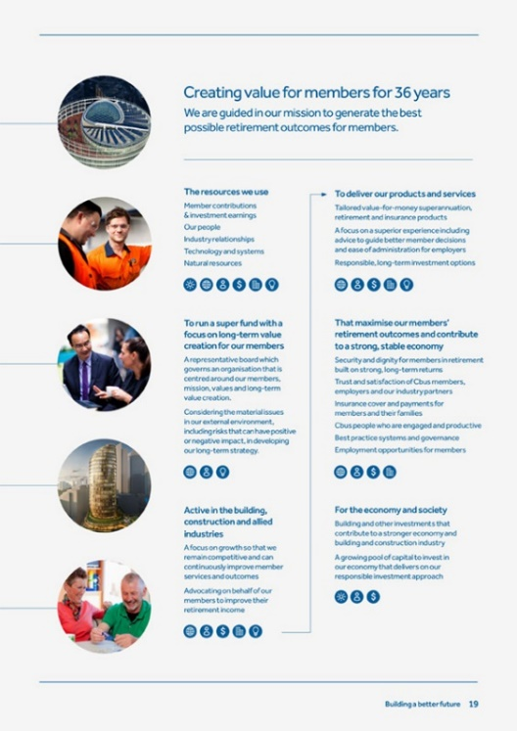
Connecting strategies and adapting our model
Flexibility of <IR> model for all profit to members pension fund – noting our P&L statement and balance sheet only tell part of the story
<IR> will help us capture broader outcomes from our investments:
Financial outcomes of investment
Impact of non financial risks on financial outcomes
Working to quantify broader outcomes which indirectly impact our members
In progress
Notes:
Cbus’ purpose is to maximise our members retirement outcomes.
Our business model is premised on several mechanisms for creating value for our members in the context of being an “all profit to members pension fund” in a compulsory defined contribution system:
However, there is no doubt that a very significant – perhaps the most significant - lever of value creation is our investment strategy.
Cbus’ investment strategy is premised on being an innovative long term investor, which adopts a total portfolio perspective and in particular integrates ESG considerations in all decision making. We focus on direct investments including in property, infrastructure and listed and unlisted companies. This strategy has seen us increase the number of internally managed portfolios where we can enhance member returns and we now manage around a third of our total funds under management inhouse. This strategy has seen us deliver cumulative savings to members of $240m between 2017-2020 in lower investment management fees. Our investment returns are top quartile across all time periods.
The fund has a detailed and long term investment strategy which is developed within the investment team. However, our investment strategy is integrated with our organisation strategy and <IR> is continuing to challenge us to deepen this integration.
As a pension fund, with long-term strategic objectives, it is challenging to define and measure all the elements of value creation, and particularly the broader outcomes of our investment activities.
Our business model differs from a for profit or manufacturing business model to the degree that its not capitals in and dividends/widgets out. Our financial statements only tell part of the story in terms of our value creation.
<IR> principles accommodate this uniqueness.
In terms of outcomes, as a long term investor we have always been able to quantify the financial benefits of our investment activity.
As I mentioned above, Cbus has also integrated a strong ESG focus into our investment decision making – we have a strong conviction that deeply understanding and managing non financial risks enables us to generate superior financial returns. For instance, Cbus’ global equities team due diligence considers how a company is managing the ‘non’ financials given that only 20% of a S&P company’s value explained by physical and financial assets, down from 83% in 1975
However there is still more work to be done on connecting the strategy to some of the capitals and reflecting the impact of our investment strategy. We have ambition to be able to better quantify broader investment outcomes such as jobs created, investment in property which also indirectly supports our members and employers through contributing to a thriving building and construction industry and importantly, reporting on carbon emission reductions in the mid and longer term in line with our 2050 net zero target. In other words, how we create value through our contribution more broadly to the world in which our members live, work and retire into.
Our engagement with the capitals in articulating value creation is maturing. The <IR> process, and in particular the merger with SASB, will further deepen a focus on holistic value measurement and metrics. As an investor a multi-capital approach discussed in the ACCA report, and a globally harmonised framework for reporting will greatly aid comparability of information for investors.
And, as an investor, we want those we invest in to take up the <IR> framework and take the challenge of open, holistic, integrated reporting. This is critical for us in meeting our objectives for our stakeholders in ensuring the investing we do on their behalf is being done sustainably over the long-term. While it is important that our members achieve strong investment returns we are conscious that our decisions will also impact the society, economy and environment they will retire into.

Slide 8
Cbus advocates <IR> for the companies we invest in
<IR> is both backward as well as forward looking
Materiality around key matters which may affect value creation
Clear focus on key strategic objectives; how measures align to strategy
Consistency and comparability to allow like-for-like comparisons across regions and sectors. Information should be holistic, relevant, concise and timely (aligned to SASB, TCFD, GRI etc)
A clear picture of the capital inputs and outcomes, be it financial, human, natural etc
Integrated into the company’s governance, management, planning and incentive structures
Considers macro impacts environment, impact on society and markets, perspectives of financial capital providers, human capital providers
Notes:
Thought it would be useful to end with noting our reflections, as an investor, on the reporting elements which we find valuable, facilitated by <IR>.
We strongly advocate and favour companies which utilise <IR> because:
<IR> is both backward as well as forward looking, with a strong focus on forward looking information and measures. However we still like to see as much relevant history as possible – ensuring investors can build a detailed understanding of the business, where it has come from, and where it is headed
Reporting on materiality - the key matters which may affect the organisation’s ability to create value
Clear focus on key strategic objectives, rather than reporting on too many measures (including those that may be much less material)
Clear explanations on why the reported metrics have been chosen, including the methodology used to derive the metrics, and how they align with the medium and long-term ambitions of the company
Consistency and comparability should be a key objective, to ensure investors can make like-for-like comparisons across regions and sectors. Information should also be relevant, concise and timely
Holistic reporting including alignment to frameworks be it SASB, TCFD, GRI, etc – which aids comparability. However an <IR> should not be confused with a sustainability report
A clear picture of the capital inputs be it financial, human, natural etc
Integrated into the company’s governance, management, planning and incentive structures
Evolving approach to consideration of macro impacts, impact on society and markets, perspectives of financial capital providers, human capital providers – the multi capital approach discussed in the ACCA paper

Slide 9
Thank you

